Slide 1
CS104 Robotics Triathlon Software Development Project
Challenges, Roles, Learnings, and Reflections

Slide 2
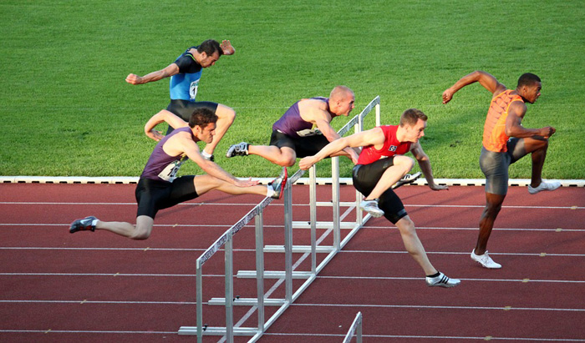
Overcoming Hurdles
Navigating the Endurance Course:
Ensuring precise navigation around using sphero with potential space constraints.
Implementing a reliable start-stop mechanism with lights and sound.
Figure Eight Accuracy:
Designing algorithms for accurate completion of the figure-eight course.
Overcoming the challenge of staying within the defined path.
Agility Obstacle Course:
Successfully avoiding objects, navigating a ramp, and toppling pins.
Balancing agility without compromising accuracy.
Collaboration and Version Control:
Coordinating tasks among team members using Github.
Managing collaborative coding and version control effectively.

Slide 3

Team Collaboration
Team Member 1: Anthony Mendes
Role: Project Manager
Contribution:
Develop a comprehensive project plan outlining tasks, milestones, and timelines.
Create a Gantt chart or project timeline for visual tracking.
Team Member 2: Peter Silvio
Role: Software Developer
Contribution:
Write and implement code for the various sprints, with a focus on Endurance, Accuracy, and Agility.
Contribute to the creation of the System Design Document, including the algorithm, flowchart, and hardware/software specifications.
Team Member 3: Lostada Kernisant
Role: Systems Designer
Contribution:
Contribute to the creation of the Executive Summary in the System Design Document, summarizing key aspects of the project.
Contribute to the development of a staffing plan, outlining the roles and responsibilities of team members in relation to system design.

Slide 4
Title: Gaining Insights and Expertise
Requirement Refinement:
Importance of thorough requirements analysis for precise system specifications.
Iterative refinement of requirements based on ongoing project developments.
Collaborative Design:
Significance of collaborative system design for seamless integration of software and hardware components.
How effective communication enhances the overall design process.
Algorithmic Efficiency:
Developing algorithms for optimal performance and scalability.
Balancing complexity with efficiency in algorithm design.
Testing Strategies:
Implementing comprehensive testing strategies to ensure the reliability and functionality of the system.
Adapting testing approaches based on the nature of the software and hardware interactions.
Agile Methodology:
Embracing the agile methodology for iterative and adaptive development.
Responding to changes promptly and adjusting project plans accordingly.
Version Control Best Practices:
Utilizing version control systems (e.g., Github) for collaborative coding and effective project management.
Understanding the importance of version history for debugging and tracking changes.

Slide 5

Continuous Improvement
Enhanced Planning:
Detailed planning for each sprint, including more granular task breakdowns.
Anticipating potential challenges and incorporating contingency plans.
Communication Optimization:
Improving communication channels for more efficient collaboration.
Implementing regular check-ins to address concerns and facilitate smoother information flow.
Risk Management Refinement:
Identifying and addressing potential risks earlier in the project.
Enhancing risk mitigation strategies to minimize their impact.
Iterative Documentation:
Documenting code changes and design decisions more comprehensively.
Implementing a more iterative approach to documentation during each sprint.
Test Plan Iteration:
Iteratively refining the test plan based on evolving project requirements.
Incorporating more diverse testing scenarios to ensure comprehensive coverage.

Slide 6
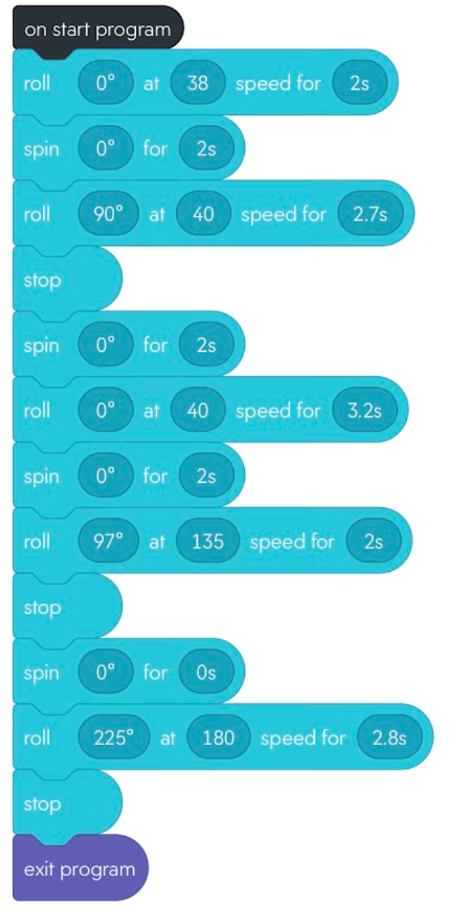
Navigating Challenges with Code
Seen here is our block code for sprint 3:

Slide 7
